Slide 1
In-situ and highly portable SVBRDF acquisition method
C. Cou, R. Pacanowski, X. Granier
Notes:
Good morning everybody.
I’m here to present you our work about a new method to acquire the reflectance in-situ, in another words, a portable SVBRDF acquisition method.

Slide 2
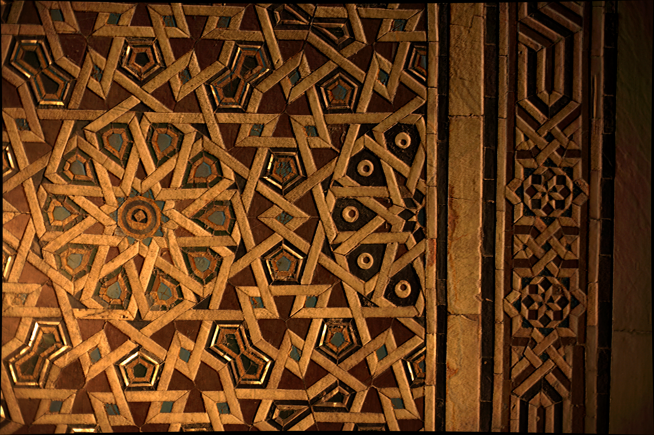
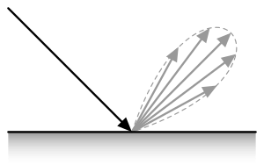
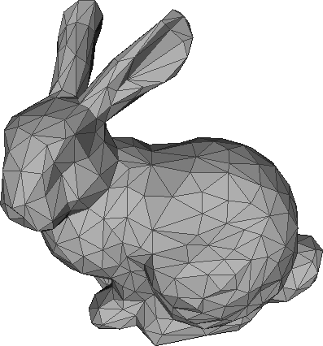
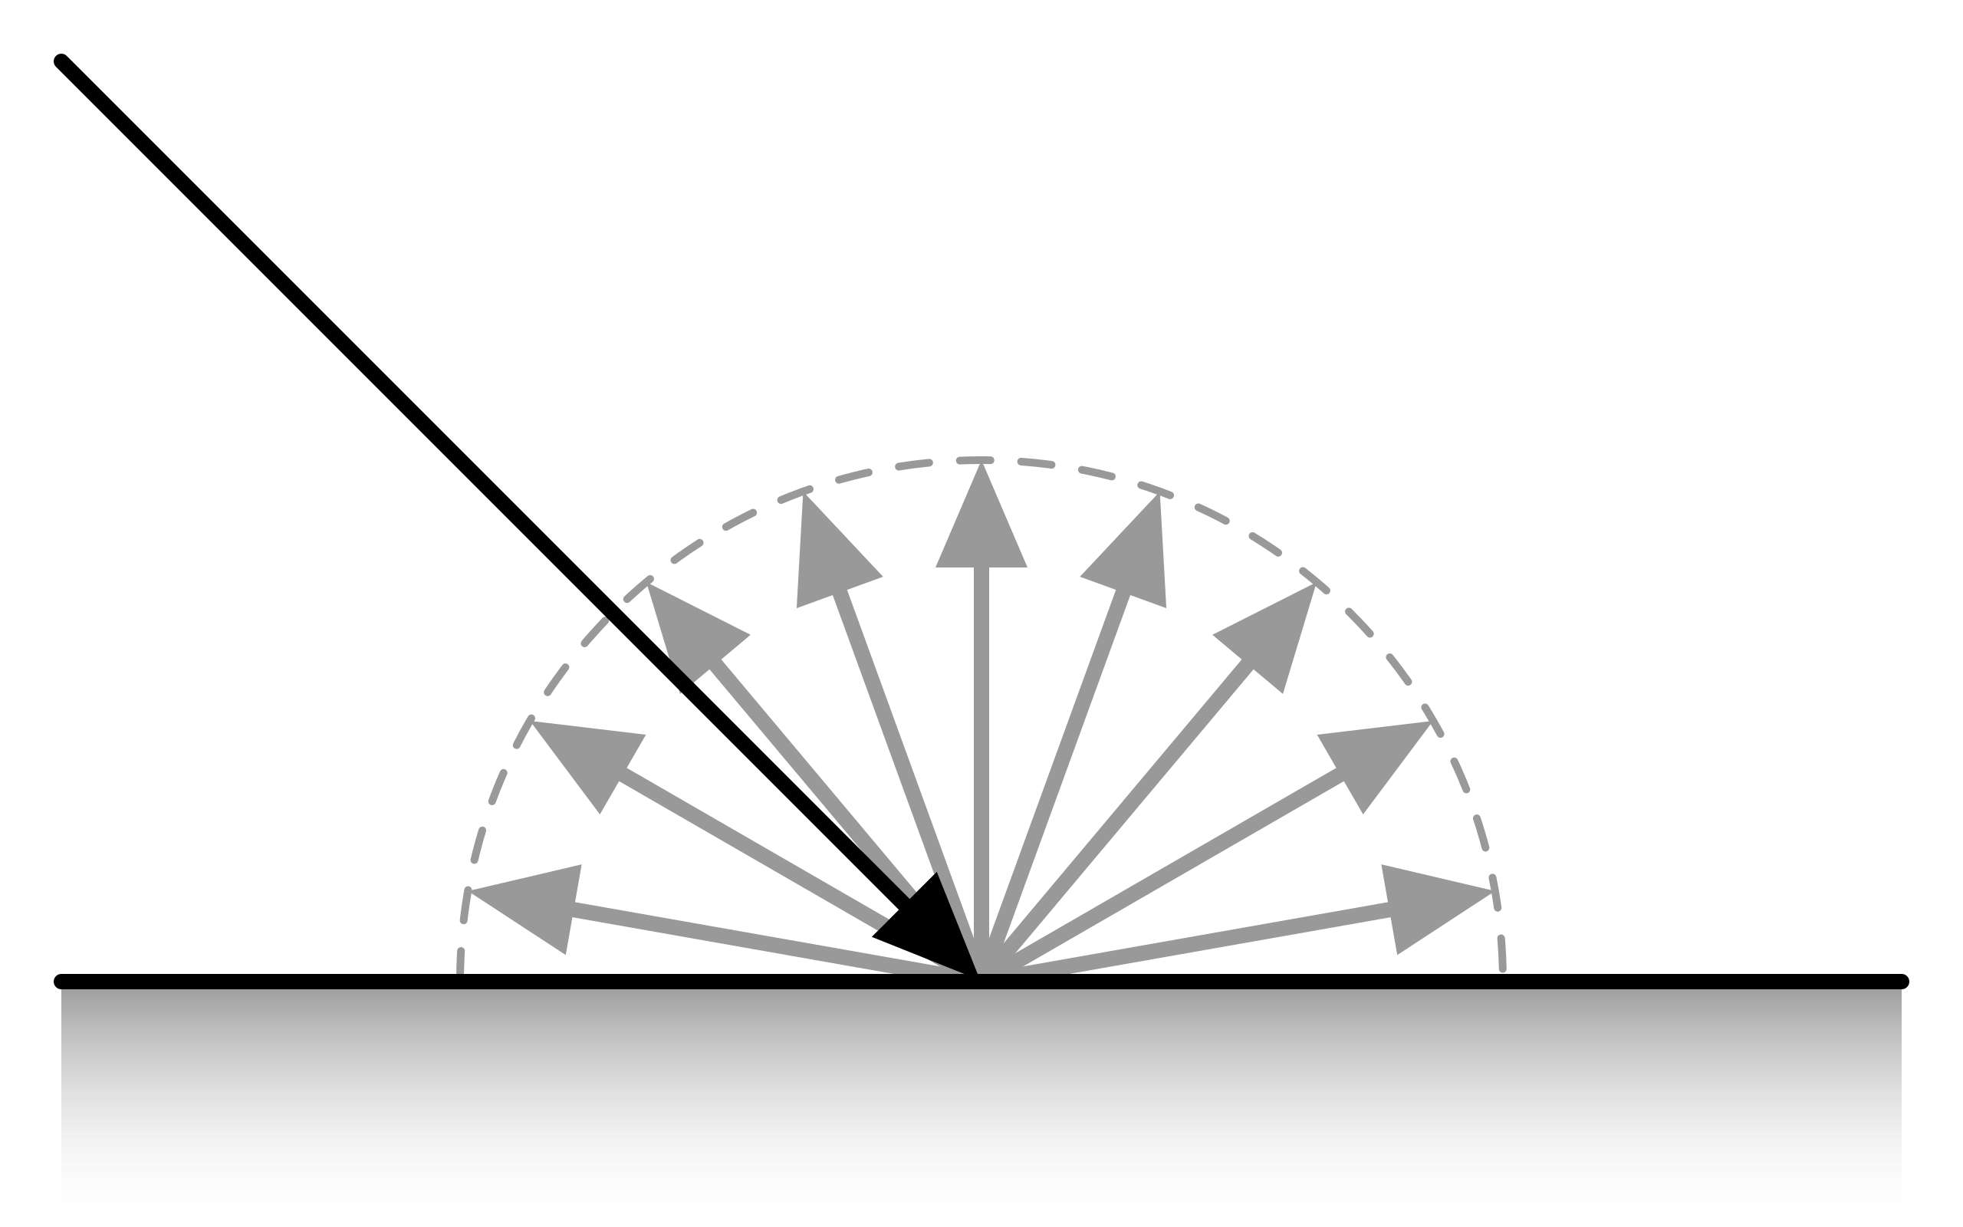
Context: capturing the real-world in situ
Goal: capture and reconstruct in situ objects
Cultural Heritage acquisition [1]
Appearance: geometry + SVBRDF $ρ\left(ω_{i},ω_{0}\right)$
Notes:
For a bit of context, we developped our method in order to capture and reconstruct digitally objects from real world.
Our use case was the acquisition of cultural heritage with the acquisition of a neo islamic residence in Cairo called Hotel Saint Maurice.
Here we can see a part of a mosaic wall we acquired.
In this context, we would like to acquire the appearance of a 3D object, that is the addition of its geometry (its 3D mesh) and its reflectance properties defined by a spatially various BRDF, a SVBRDF.
As we can see on this diagram, the spatially varying BRDF is a BRDF function that depends on the
Light direction wi and View direction wo,
And that varies on each point of the mesh.

Slide 3
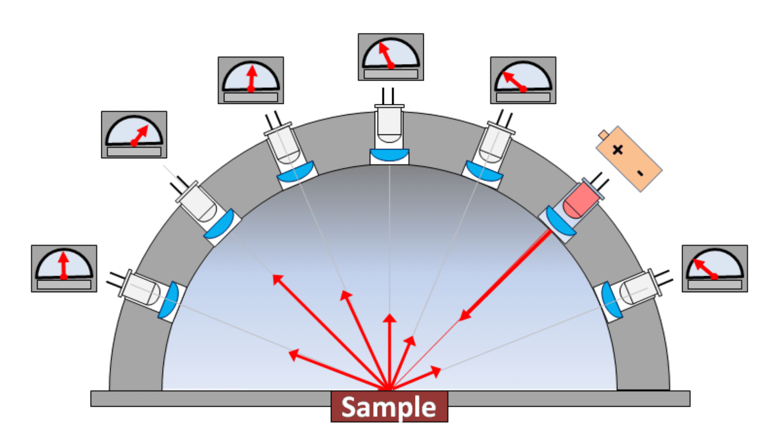
The light/view angular distribution problem
Need for a calibrated dense sampling
Light direction ($ω_{i}$)
View direction ($ω_{o}$)
Easier in laboratories
More complicated for uncontrolled environment
Good calibration but sparse light distribution
Hemispherical light dome set-up [1]
Portable set-up [2]
Notes:
The main problem to overcome when acquiring SVBRDF is the need for a calibrated dense sampling of the light and the view angular distributions.
Indeed, for a good BRDF measurement, we need to capture as well as possible the light direction and the view direction from all the hemisphere around the normal.
In the case of a SVBRDF, it has to be captured for each point of the mesh.
This capture has to be precise, so that is requiring a calibration of the view position, but also for the light.
This is possible in laboratory, as in this example with an hemispherical light dome set-up. This light dome contains a well representative distribution of light in the hemisphere at known positions.
But it becomes more complicated for in situ environments which are uncontrolled environments.
Set-ups are less precise, or a good calibration requires a sparse and unrepresentative light distribution.
This example is a good one and show a flashlight and a camera connected together: so the light and the view are always paraxial.

Slide 4
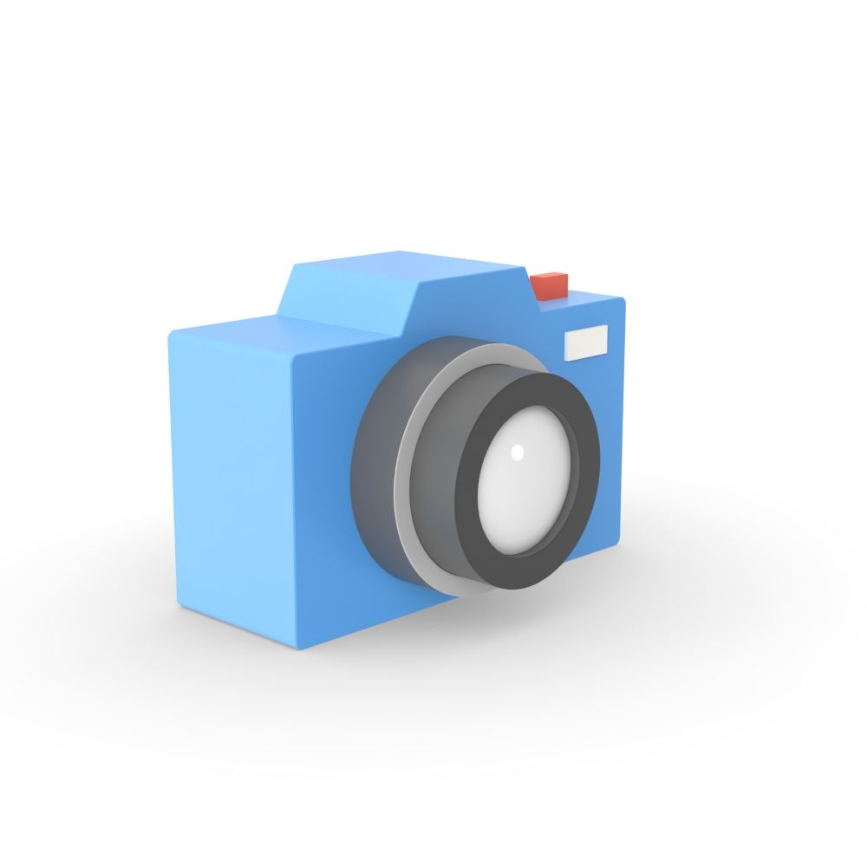
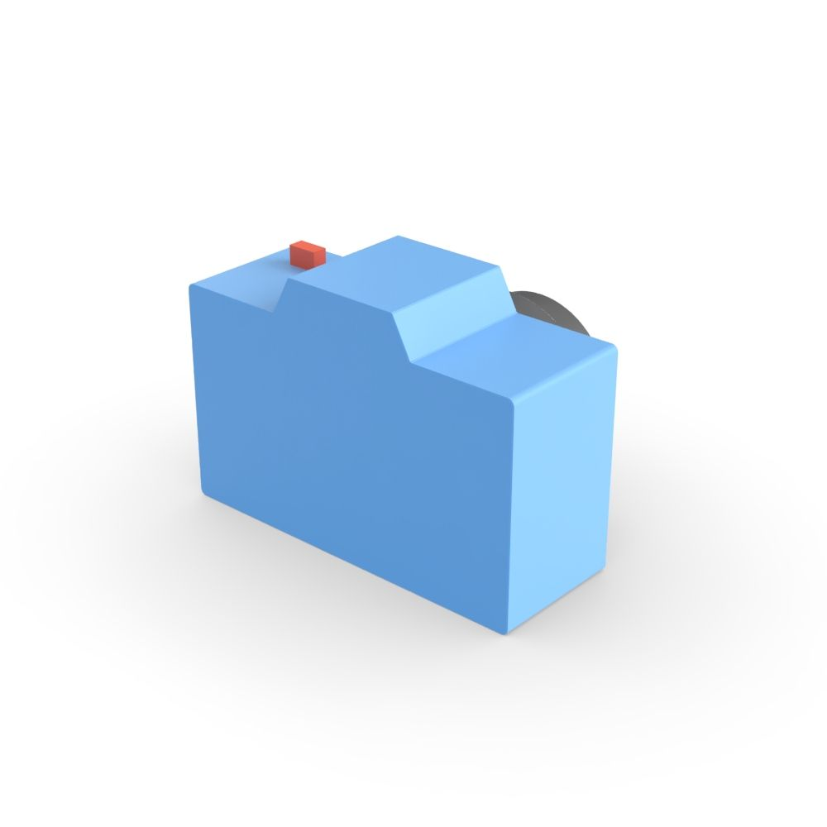
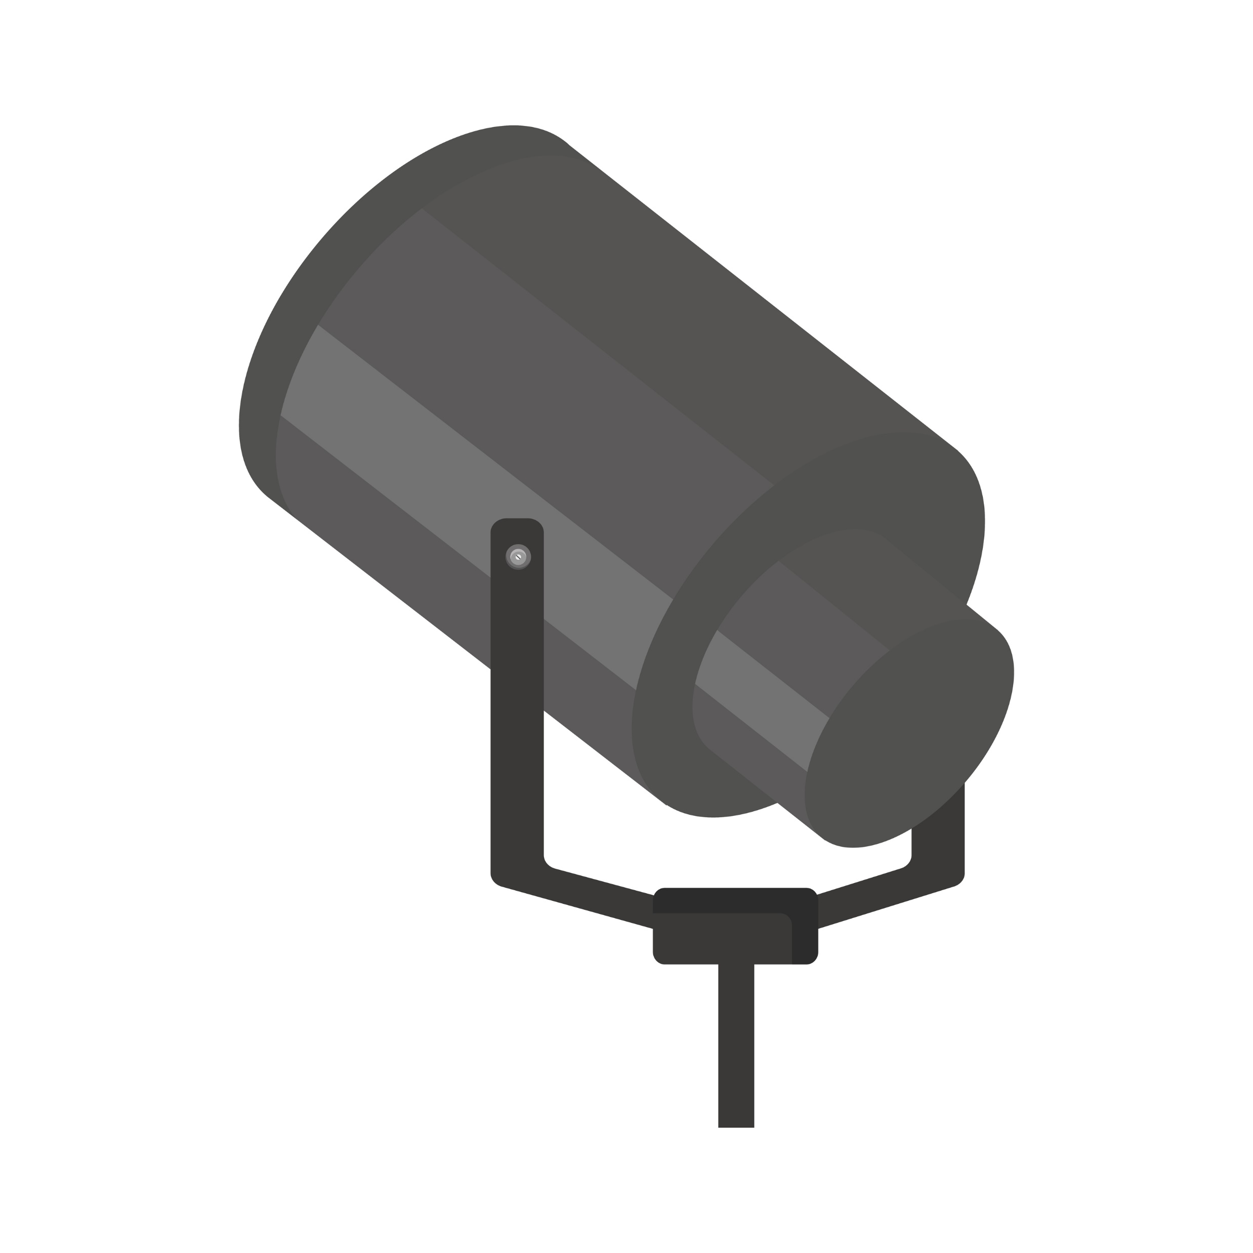
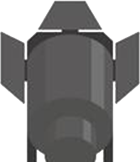
A new approach
Mirror spheres
Studied object
Spectralon
Camera light
Camera scene
Notes:
In this context of light/view space problem, we developed an approach which enables fast light position calibration,
Which is scalable, and easy to transport on site.
First, we place two mirror spheres close to the studied object.
Usually, we can capture a mirror sphere in order to get a light direction.
Using two spheres, we can get the light position by crossing the information of the two spheres, in front of a camera that we call « camera light ».
Then, we place a white reference, a spectralon, and a camera called « camera scene » in front of the studied object.
This camera captures the object under different illuminations and positions, so it captures the intensity that is used to get the SVBRDF.
The next part is an iterative one: we place the light in the scene in order to illuminate the studied object,
Then we take a picture of the spheres with the camera light to get the light position, and a picture of the scene with the camera scene.
We change successively the positions of the light (with a picture taken by the camera light) and the positions of the camera scene.
At the end, we have a representative sampling of the light/view hemispheres.

Slide 5
From images data to BRDF measurements
Mesh (photogrammetry)
Camera calibration:
Intrinsic parameters
Camera position [1]
Pinhole camera model
New light calibration:
Light position
Light intensity
Disc source model
SVBRDF measurements
Our main contribution: modelization of the light source as a disc
Notes:
We end up with lots of images and we would like to exploit them to get SVBRDF measurements.
The first two parts do not bring any new contribution.
The first one is the recovering of the shape of the object which using photogrammetry techniques with Metashape software.
The second is the calibration of our camera, that is modeled with a pinhole camera model, using Zheng et al. reconstruction method.
Thanks to this, we get the view directions.
Finally, we get a contribution on the calibration of our light following a disc source model.
This calibration is done in term of intensity, but also in order to get the position and direction of our light spot.
It is basically done by doing an inverse rendering between a synthetic scene and the photographs captured by the camera light.
Thanks to this, we have the light directions too.
So finally, we get some SVBRDF measurements.

Slide 6
From BRDF measurements to BRDF model
Numerical optimization with a microfacet model:
Lambertian (3 parameters)
GGX distribution (1 parameter)
Fresnel term (3 parameters = IOR)
Optimizing the normals of the surface
Minimization between synthetic images and acquired photographs
Iterative
process
Notes:
At this point, we have BRDF measurements represented by a value for couples light-view directions at each point on the mesh surface.
Since the measurements are not dense, we want to generate a BRDF model more than only measurements, in order to generate a complete 3D object with its reflective properties.
For this, we first decimate and denoise our BRDF measuremen data.
Then, we fit our measurements with a microfacet model composed by a lambertian diffuse part and a GGX distribution associated with a Fresnel term for the specularities.
After this, we have BRDF models applied to a rough mesh. And we want to enhance it by optimizing the normals on the surface.
This minimization is made between synthetic reconstructed images and acquired photographs.
But because we have new normals, it means that wo and wi are not good anymore.
That is why we apply an iterative process.
After 2 or 3 iterations, the procedure converges and we obtain a complete 3D object with its shape + SVBRDF

Slide 7
Evaluation of the set-up in laboratory
Real pictures
Rendered images
Other rendered images
Notes:
Now, let me present you some evaluations of our method/pipeline
First, we evaluate it on this Balinese mask captured in laboratory.
As we can see, the results are quite close between the real photographs on the left and the rendered images with the same view and light conditions in the center.
This acquisition in lab already presents the good sides and the limitations of our method.
When we zoom in on the top of the white mask, we see that the microstructures are particularly faithful.
Here, the painting wood and the details are coherent.
But the main drawback of the method is visible when we zoom in on the eye.
As we can see, the shininess is hard to capture.
We can explain this by the fact our measure is representative but not dense enough.
So, we miss the specular peak in some cases.
The fitting algorithm cannot match the sharpness of the reality

Slide 8
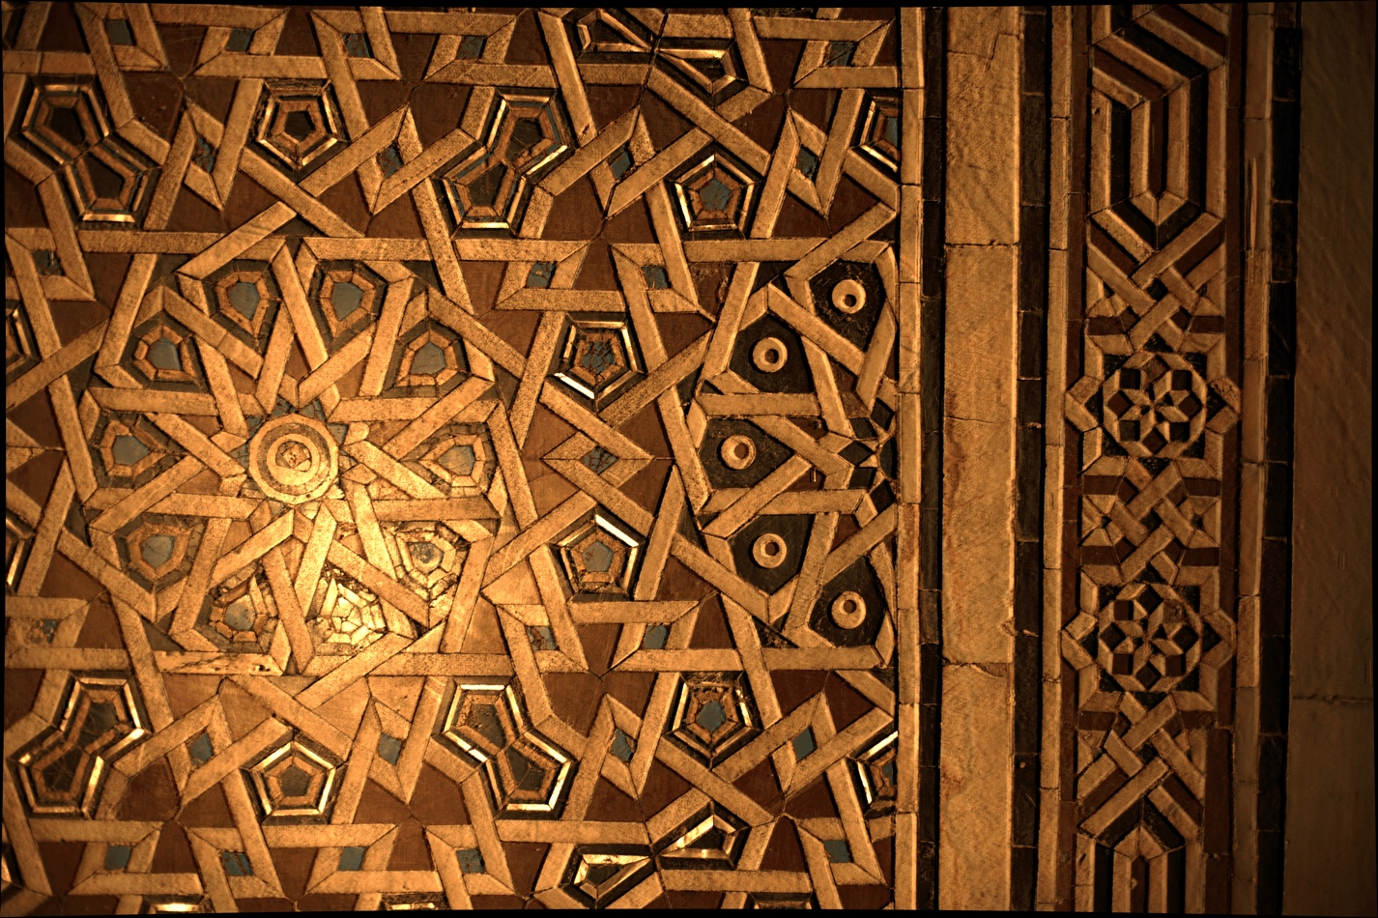
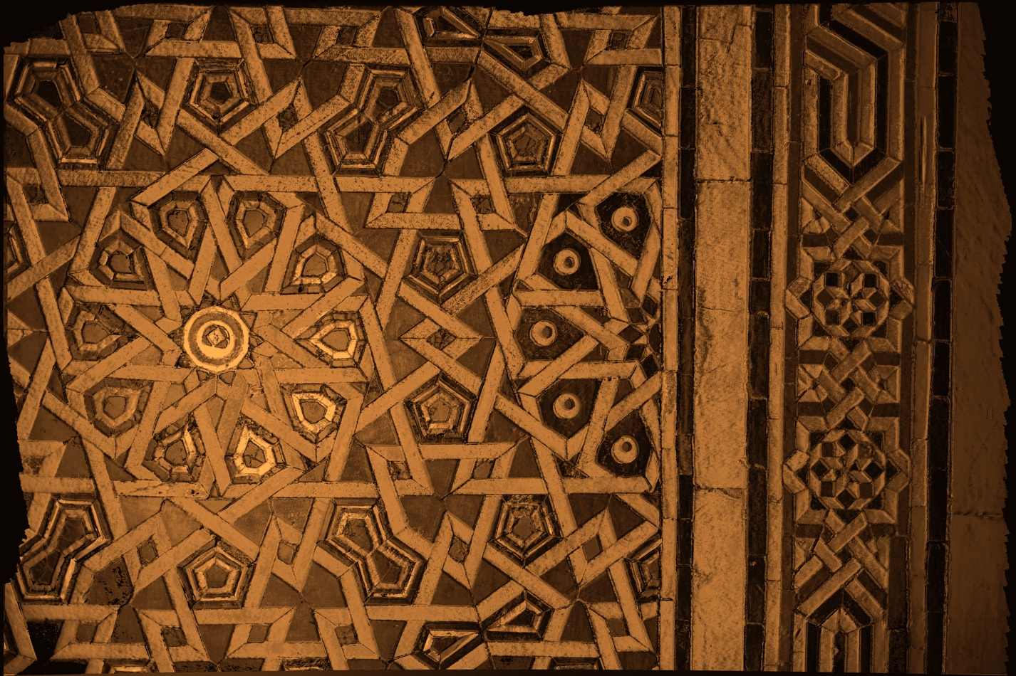
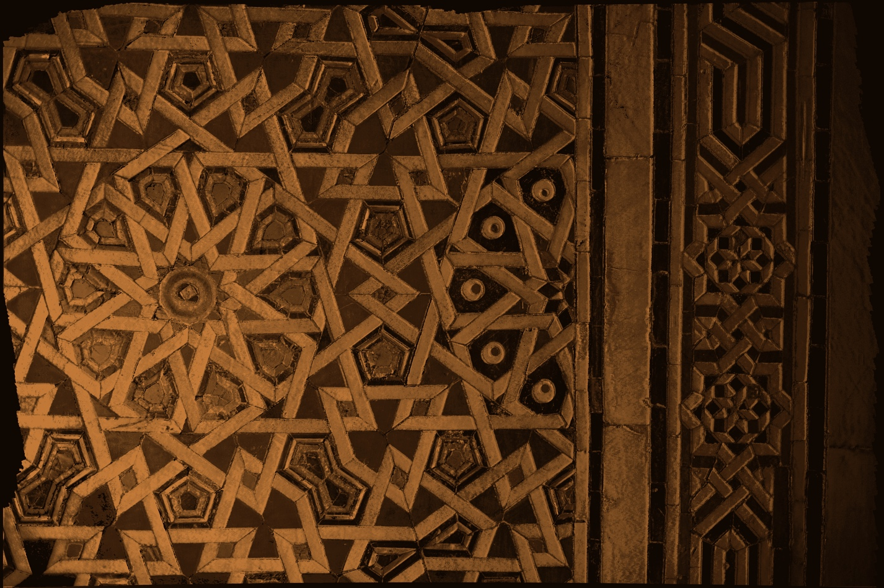
Results in situ (Hotel Saint Maurice)
Real pictures
Rendered images
Notes:
This pros and cons are the same when we observe OUR results from our on site measurements made in St Maurice residence in Cairo.
This zoomed part here on a mosaic wall captured shows that the shininess is hard to be measured
Our results are systematically more diffuse for shiny materials.
But we should not forget that the capture is really good for microstructures as we can see on the bottom:
Cracks, wall imperfections, and variations are much better recovered than in a classic 3D acquisition.

Slide 9
Future work
The specular peak enhancements
Improving the capture
Improve metric for numerical fitting
Comparisons against measurements from NMI
Notes:
As future work for overall improvement:
First, we must enhance the specularities by improving the capture with something denser or more representative, and the metric for the numerical fitting.
Our metric now focus more on the diffuse part.
Finally, some metrology should be interesting in order to compare objectively our results with some references, with
NMI = National Metrological Institutes.

Slide 10
Thanks for your attention

Slide 11
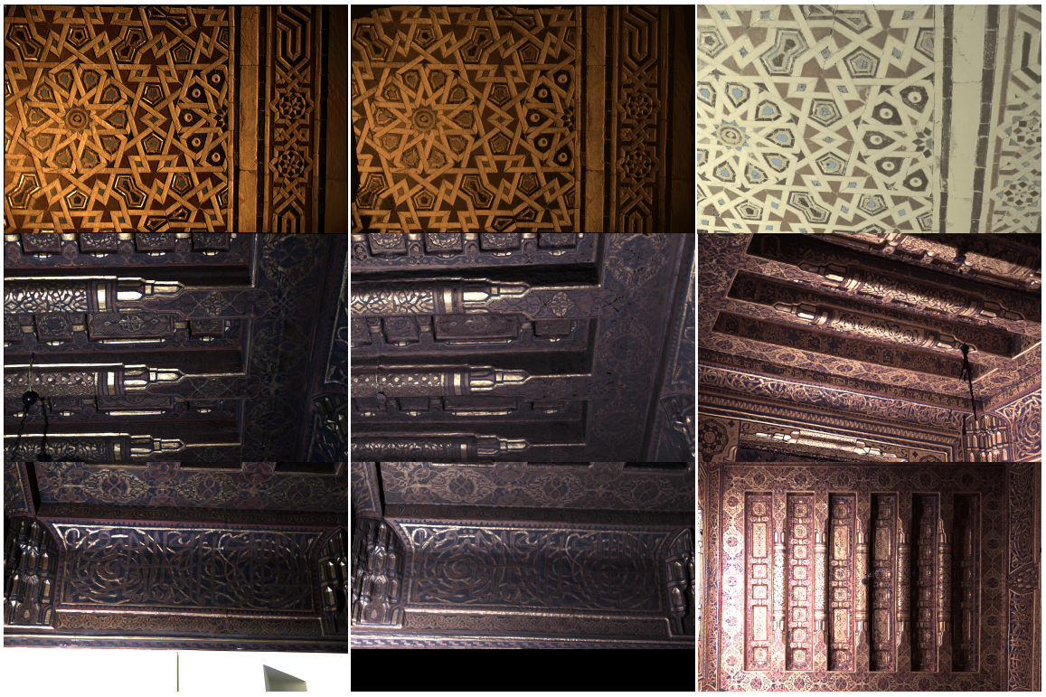
Results in situ (Hotel Saint Maurice)
Real pictures
Rendered images
Other rendered images
Notes:
3e colonne : slide supplémentaire
Ecarter chaque ligne
Zoom sur les trucs à montrer + écrire les mots
Infos de chaque colonne en haut
Garder que deux images
Context dans le titre

Slide 12
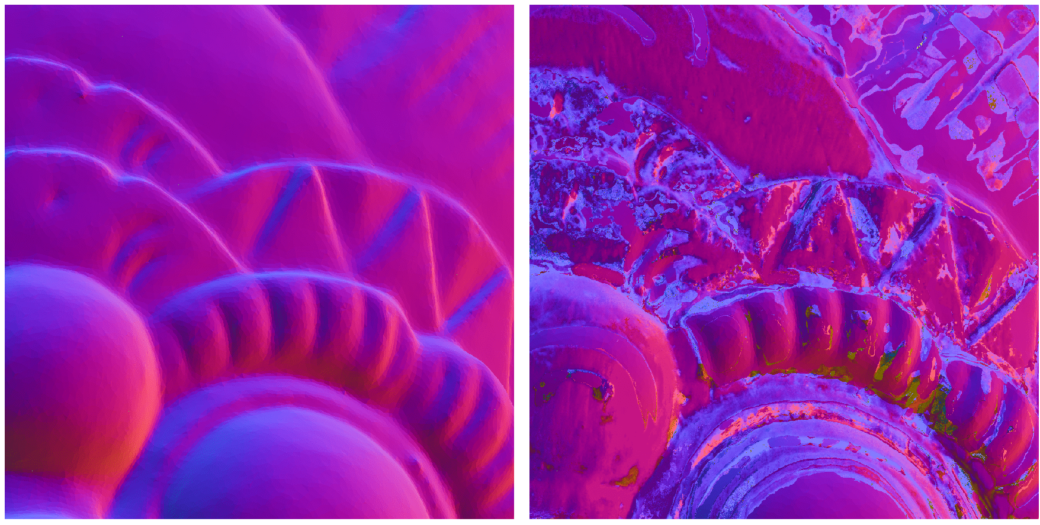
Before/After normal optimization

Slide 13
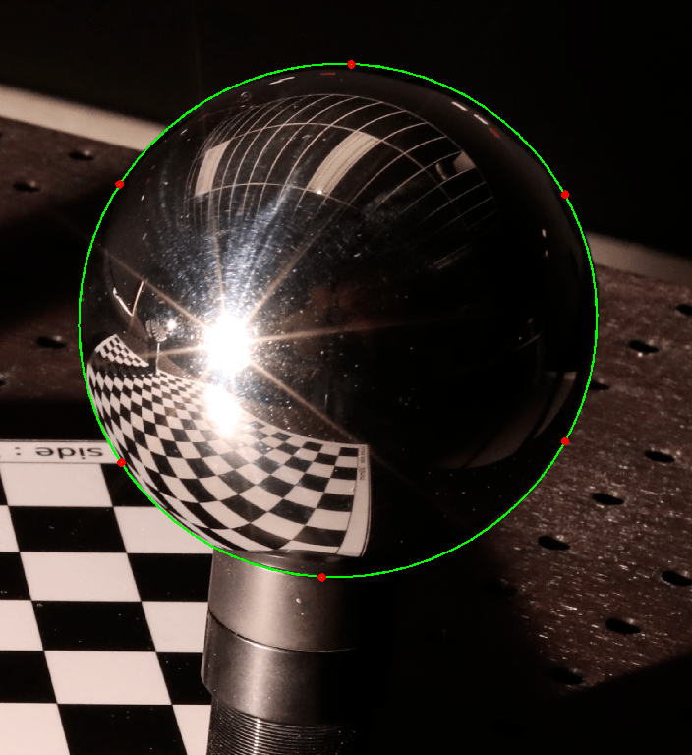
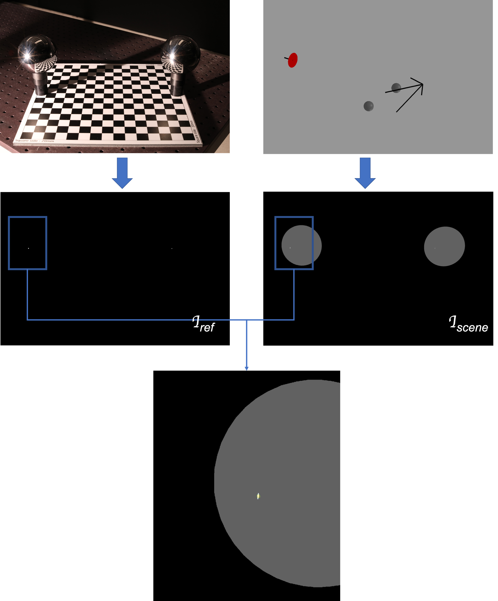
Fast calibration of the light position
Sphere detection on photograph with ellipse fitting
Sphere position optimization with a ray tracing projection from the photograph on a synthetic scene
Inverse rendering between the synthetic scene and the photograph for the light position

Slide 14
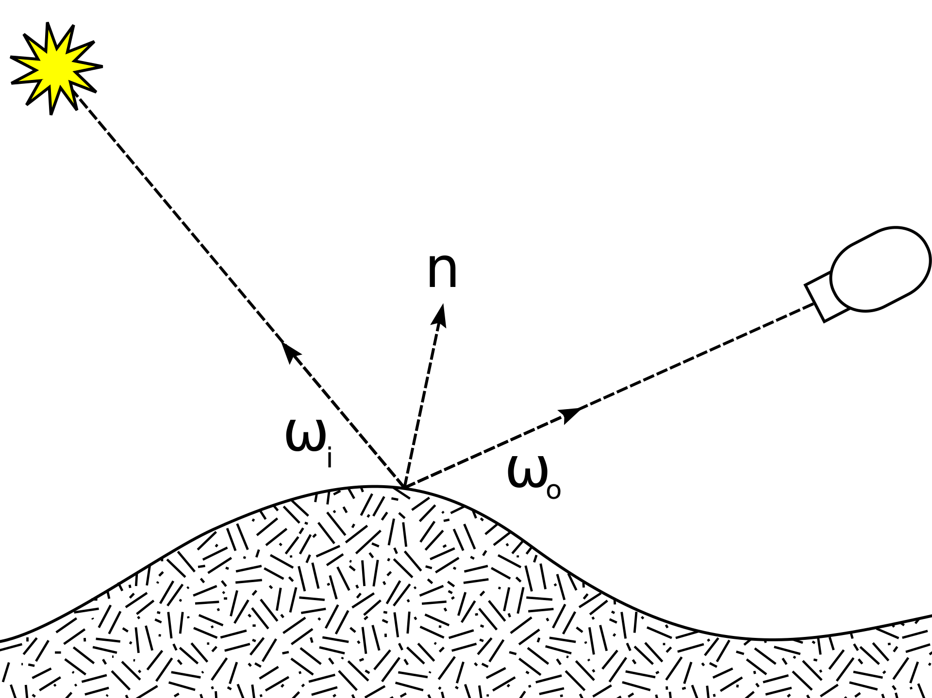
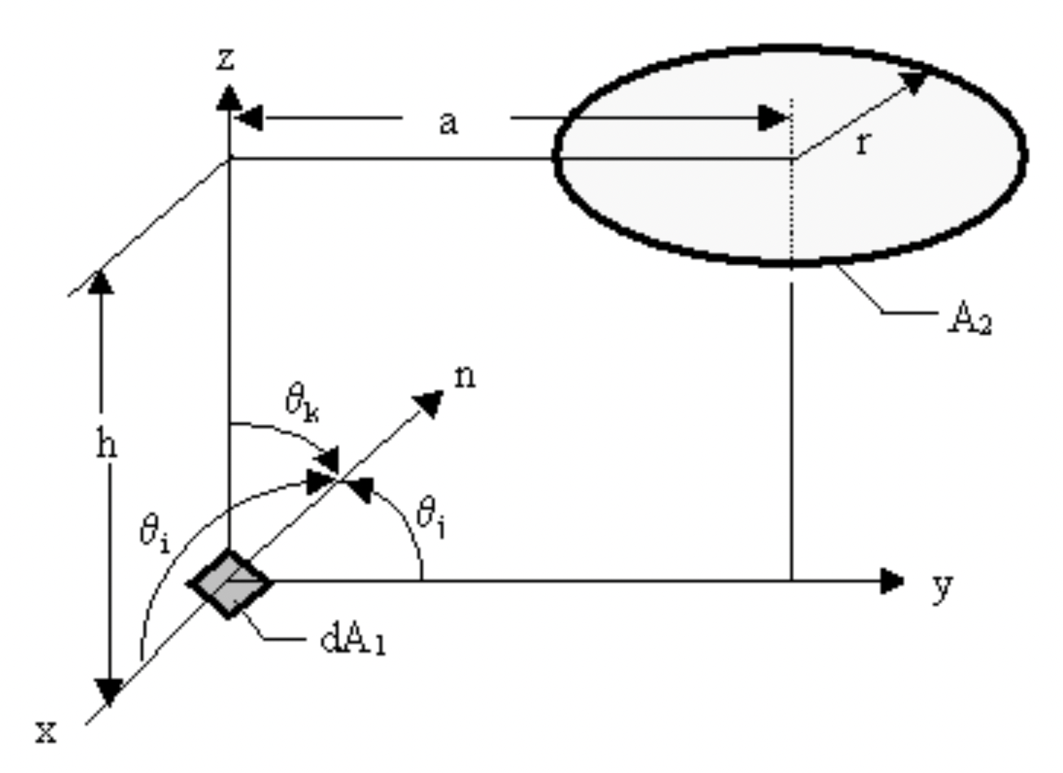
Disc source over point source model
Point source model:
$ρ\left(ω_{i},ω_{0}\right)=V_{point}\frac{F_{o}}{F_{i}}$
with $V_{point}=\frac{δ_{i}^{2}}{\cos{θ_{i}d_{ω_{i}}}}$
Disc source model:
$ρ\left(ω_{i},ω_{0}\right)=V_{disc}\frac{F_{o}}{F_{i}}$
with $V_{disc}=\frac{1}{2}\left(\left(\cos{θ_{k}−H\cos{θ_{j}}}\right)+\frac{HZ\cos{θ_{j}}}{P}−\frac{1 −H^{2}−R^{2}}{P}\cos{θ_{k}}\right)$
$\left\{\begin{aligned}H= h/a \\ R= r/a \\ Z=1+ H^{2}+R^{2} \\ P= {\left(Z^{2}−4R^{2}\right)}^{1/2}\end{aligned}\right.$
$$δ_{i}$$

Slide 15
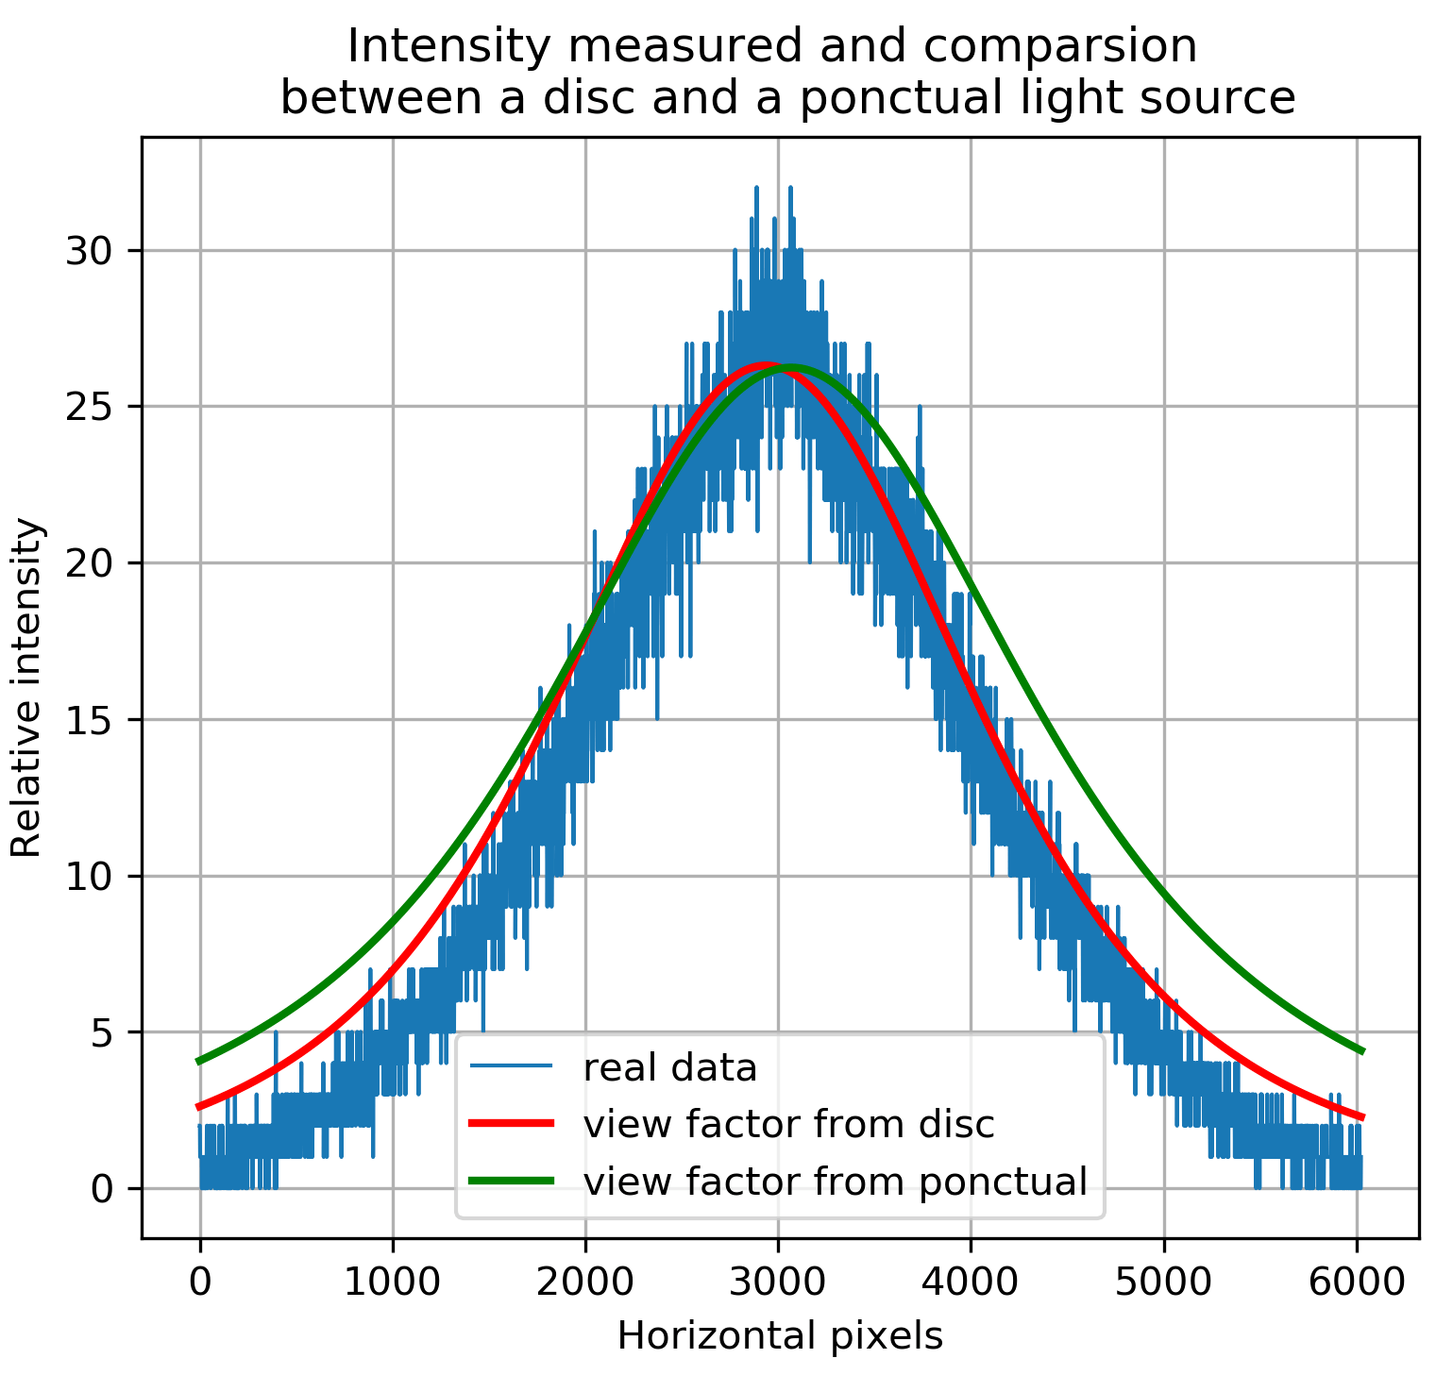
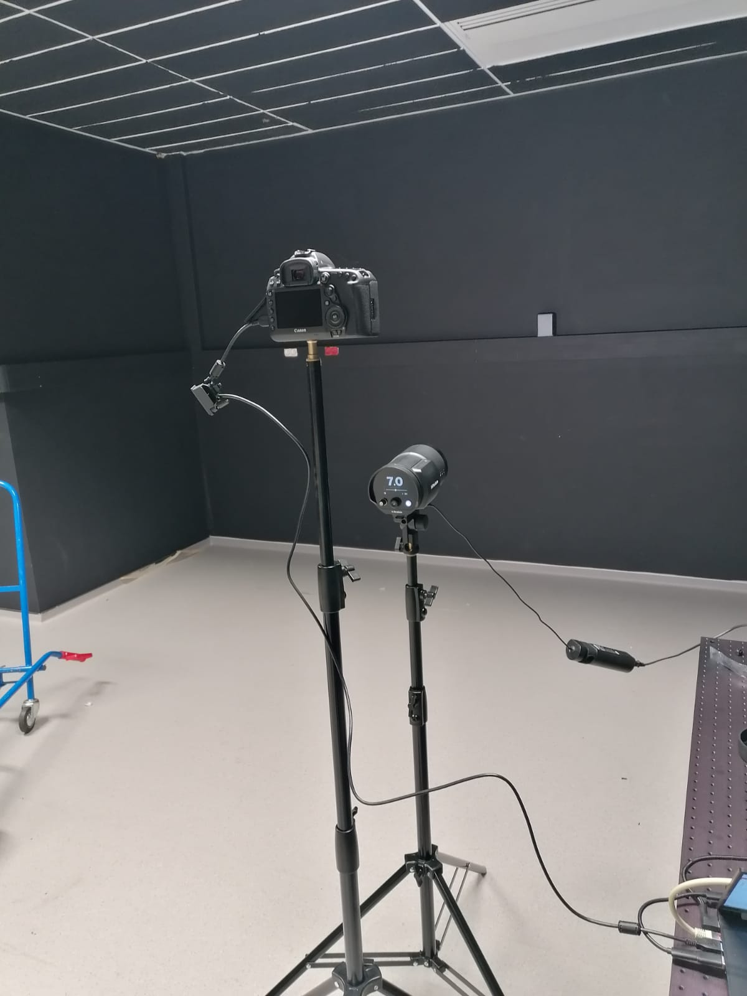
Disc source over point source model
Photograph of a quasi diffuse wall and model comparison

Slide 16
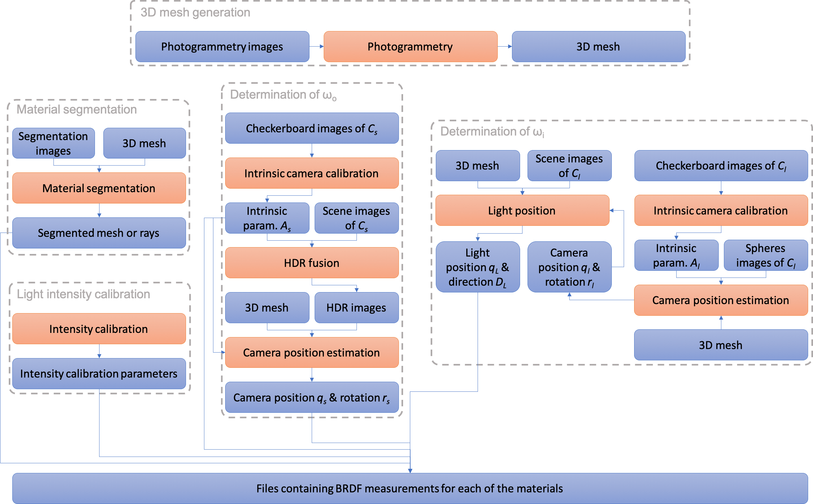
From image data to BRDF measurements

